Slide 1
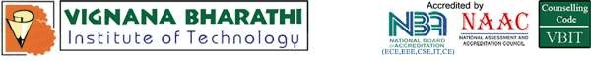
Navigation of NanoTablets to Target Organs Using Pathfinding Algorithm
Batch No: 21PA01
A.Dinesh (21P61A0506) B.Piyush (21P61A0525) B.Shirisha (21P61A0530)
Dr. N. Swapna.
Associate Professor
Department of Computer Science and Engineering

Slide 2
ABSTRACT AND KEYWORDS
Overview of pathfinding algorithms (A* algorithm) for navigating nanoparticles to target organs for improved therapeutic efficacy. With advancements in nanomedicine, the precision of nanoparticle delivery is crucial for improving therapeutic efficacy and minimizing side effects.
Keywords : Nanomedicine, nanoparticle delivery, A* algorithm, pathfinding, targeted therapy.

Slide 3
INTRODUCTION
Nanotechnology has revolutionized medicine, offering new approaches to diagnostics, treatment, and drug delivery systems designed to carry therapeutic agents directly to diseased tissues, reducing the systemic side effects associated with conventional drugs
Ensuring that nanoparticles reach specific organs or tissues without affecting healthy cells is vital for maximizing therapeutic benefits while minimizing toxicity.
Biological barriers such as the blood-brain barrier, complex vasculature, and immune system responses make it difficult for nanoparticles to reach certain organs effectively.

Slide 4
LITERATURE REVIEW
S.NO | TITLE | AUTHORS | YEAR | OBJECTIVE | METHODOLOGY |  | FINDINGS | RESULTS | LIMITATIONS | FUTURE WORKS
1 | Applications of nanoparticle systems in drug delivery technology | Syed A.A. Rizvi, Ayman M. Saleh | 2018 | To review the advancements in nanoparticle technology for drug delivery systems. | Literature review on nanoparticle applications and characteristics. |  | Nanoparticles can enhance drug formulation and delivery, improving efficacy and reducing side effects. | Highlighted the role of size and surface properties in enhancing drug delivery efficiency. | Limited focus on specific diseases; general overview may lack detailed insights into individual applications. | Future research should explore specific disease applications and optimize nanoparticle designs for targeted therapies.
2 | Nanotechnology in Drug Delivery | Tao S.L., Desai T.A. | 2005 | To discuss various nanoparticle-based drug delivery systems and their characterization techniques. | Review of existing nanoparticle synthesis, characterization, and application methods. |  | Various synthesis methods exist, each affecting the properties and efficacy of nanoparticles. | Emphasized the importance of size, shape, and surface charge in determining drug release kinetics. | Lack of comprehensive data on long-term stability and toxicity of nanoparticles. | Further studies needed to evaluate long-term effects and optimize synthesis methods for better performance

Slide 5
3 | Perspective on nanoparticle technology for biomedical use | Various Authors | 2016 | To provide an overview of nanostructured materials for diagnostics, drug delivery, and imaging. | Comprehensive literature review covering synthesis, characterization, and applications of nanoparticles. |  | Nanoparticles show promise in various biomedical applications due to their unique properties. | Identified key roles of surface modification and biocompatibility in enhancing therapeutic efficacy.. | Insufficient data on the toxicological impacts of nanoparticles in clinical settings. | More research is needed to address safety concerns and improve the biocompatibility of nanoparticles in medical applications.
4 | Nanoparticles: Properties, applications and toxicities | Khan Ibrahim, Saeed Khalid, Khan Idrees | 2019 | To provide a detailed overview of nanoparticle properties, synthesis methods, and their applications. | Review of literature focusing on synthesis techniques, properties, and toxicological assessments |  | Comprehensive understanding of nanoparticle properties is essential for their safe application in medicine. | Discussed the balance between therapeutic benefits and potential toxicities associated with nanoparticles. | Limited information on real-world clinical applications; more empirical studies needed to validate findings. | Future work should focus on developing safer nanoparticles with reduced toxicity profiles for clinical use.
5 | Therapeutic Nanoparticles and Their Targeted Delivery Applicationsbased on Python Implementation | Varios Authors | 2020 | To explore the potential of therapeutic nanoparticles for targeted delivery in various diseases. | Review of current strategies for nanoparticle design and targeting mechanisms in therapy. |  | Therapeutic nanoparticles can enhance delivery efficiency while minimizing side effects. | Highlighted the significance of understanding nanoparticle interactions within biological systems. | Challenges remain regarding the specificity and efficiency of targeting mechanisms used in therapy. | Future research should aim to refine targeting strategies to improve therapeutic outcomes across various diseases.

Slide 6
6 | Applications of nanotechnology in medical field: a brief review | Haleem Abid et al. | 2023 | To summarize recent advancements in nanotechnology applications within medicine. | Literature review covering various medical applications of nanotechnology including drug delivery and imaging techniques. |  | Nanotechnology has transformative potential across multiple medical fields including diagnostics and therapy. | Emphasized the versatility of nanotechnology in enhancing treatment efficacy across various conditions. | Lacks detailed case studies or empirical data supporting claims made about effectiveness. | Future works should focus on specific case studies that demonstrate successful applications in clinical settings.

Slide 7
PROBLEM STATEMENT
Difficulty in navigating nanoparticles to specific organs due to biological barriers
Inefficiencies in current delivery systems leading to suboptimal therapeutic effects.

Slide 8
OBJECTIVES
To develop a computational model for nanoparticle navigation using the A* algorithm
To evaluate the effectiveness of different nanoparticle designs and properties
To simulate real-world conditions for nanoparticle delivery to target organs.

Slide 9
SYSTEM AND HARDWARE REQUIREMENTS
Software Requirements (Recommended)
Operating system: Windows.
Programming Languages: Python .
Framework and libraries: MATLAB,Matplotlib.
Tools : Blender, Unreal engine 5.
Hardware Requirements(Recommended)
Computer Processor: Modern multi-Core processor ( Intel core i5)
RAM: 8 GB or higher
Graphics Processing unit (GPU) : NVIDIA GPU with CUDA support

Slide 10
PROPOSED METHODOLOGY
The proposed system makes use of :
Modeling the Vascular Network:
Create a graph representation of blood vessels and organs.
Algorithm Implementation:
Utilize the A* algorithm for optimal pathfinding.
Simulation and Analysis:
Run simulations to assess nanoparticle behavior and delivery efficiency.

Slide 11
MODULES
- Modeling
- Algorithm implementation
- Simulation and analysis

Slide 12
IMPLEMENTATIONS DONE SO FAR
We have conducted research on various suitable algorithms for nanoparticle navigation and concluded that the A* algorithm is best suited for this approach.
The A* algorithm is highly effective for pathfinding because it combines both the cost to reach a node (known as the "g-cost") and the estimated cost to reach the target (the "h-cost" or heuristic). This balance between known and estimated costs allows A* to find the shortest, most efficient path in complex environments, making it ideal for navigating nanoparticles through intricate vascular networks within the body.
Also we have studied about implementing A* in Simulation tools like Unreal Engine using Blender etc.

Slide 13
IMPLEMENTATION CODE
TArray<AStarNode*> AStarAlgorithm::FindPath(AStarNode* StartNode, AStarNode* EndNode)
{
OpenList.Add(StartNode);
AStarNode* EndNode = GetNodeByCoordinates(TargetX, TargetY);
if (EndNode == nullptr)
{
UE_LOG(LogTemp, Error, TEXT("EndNode is null!"));
return TArray<AStarNode*>();
}
while (OpenList.Num() > 0)
{
AStarNode* CurrentNode = OpenList[0];
for (AStarNode* Node : OpenList)
{
if (Node->FCost < CurrentNode->FCost || (Node->FCost == CurrentNode->FCost && Node->HCost < CurrentNode->HCost))

Slide 14
{
CurrentNode = Node;
}
}
OpenList.Remove(CurrentNode);
ClosedList.Add(CurrentNode);
if (CurrentNode == EndNode) break;
}
TArray<AStarNode*> Path;
AStarNode* Node = EndNode;
while (Node != nullptr)
{
Path.Add(Node);
Node = Node->Parent;
}
Algo::Reverse(Path);
return Path;
}

Slide 15
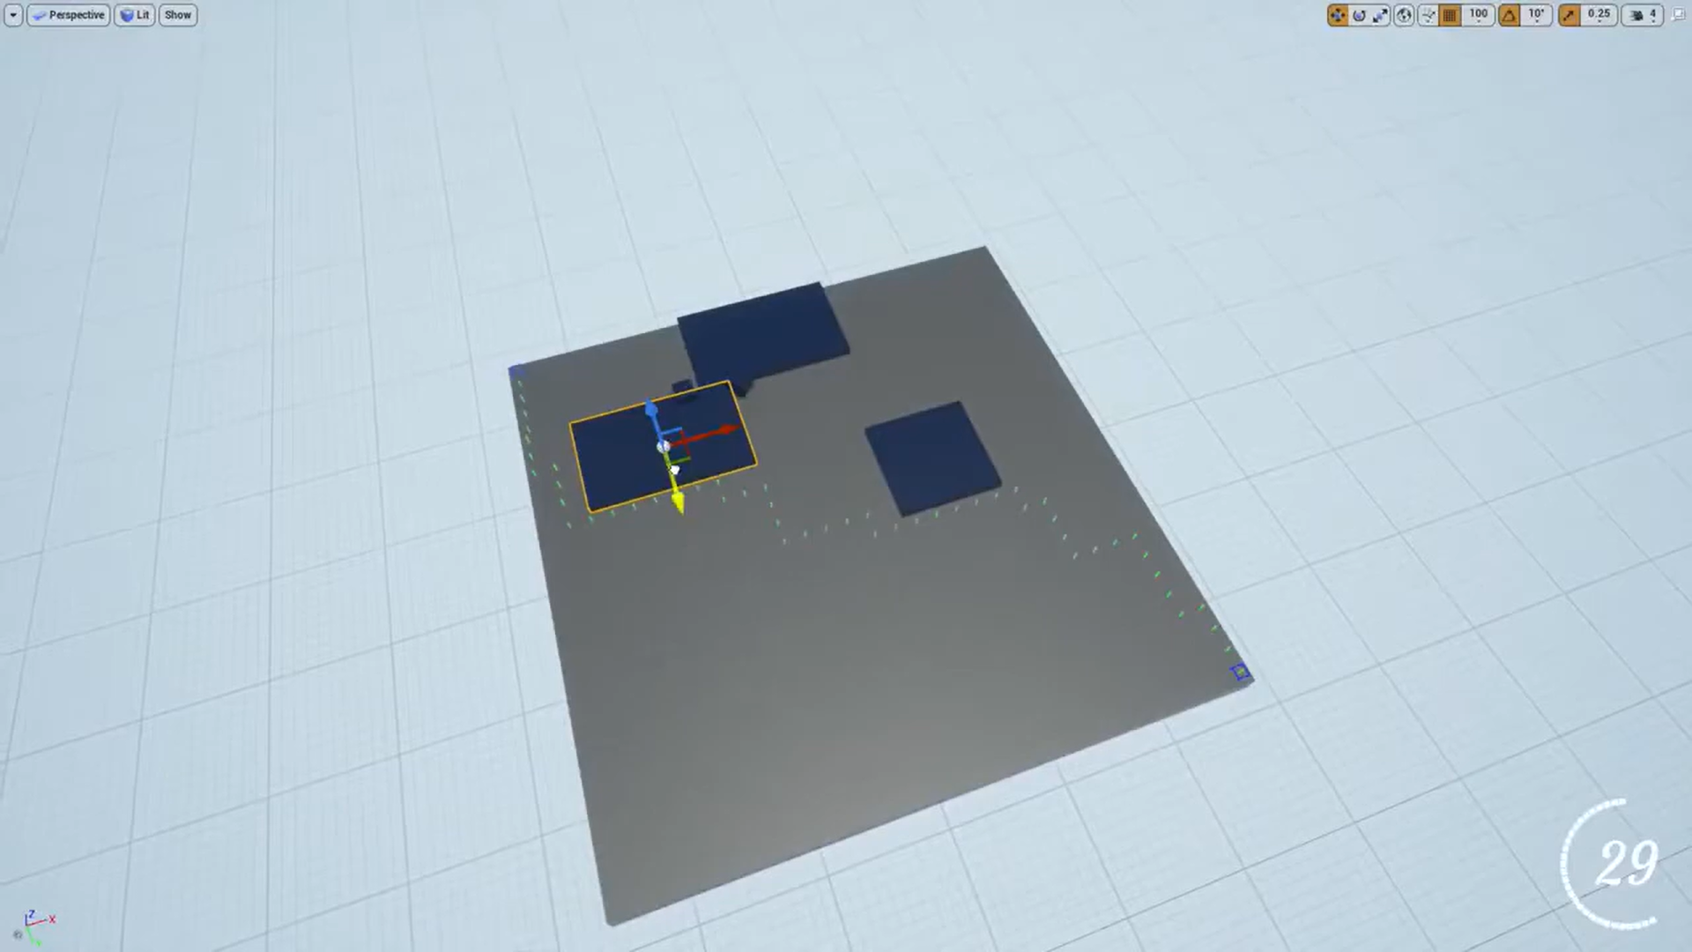
RESULTS

Slide 16
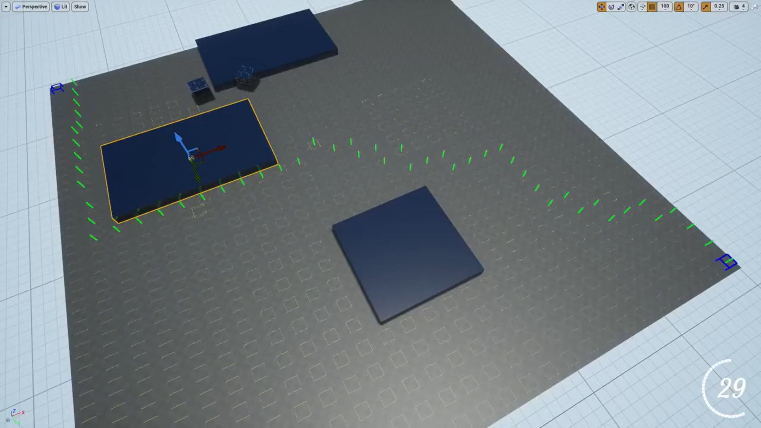
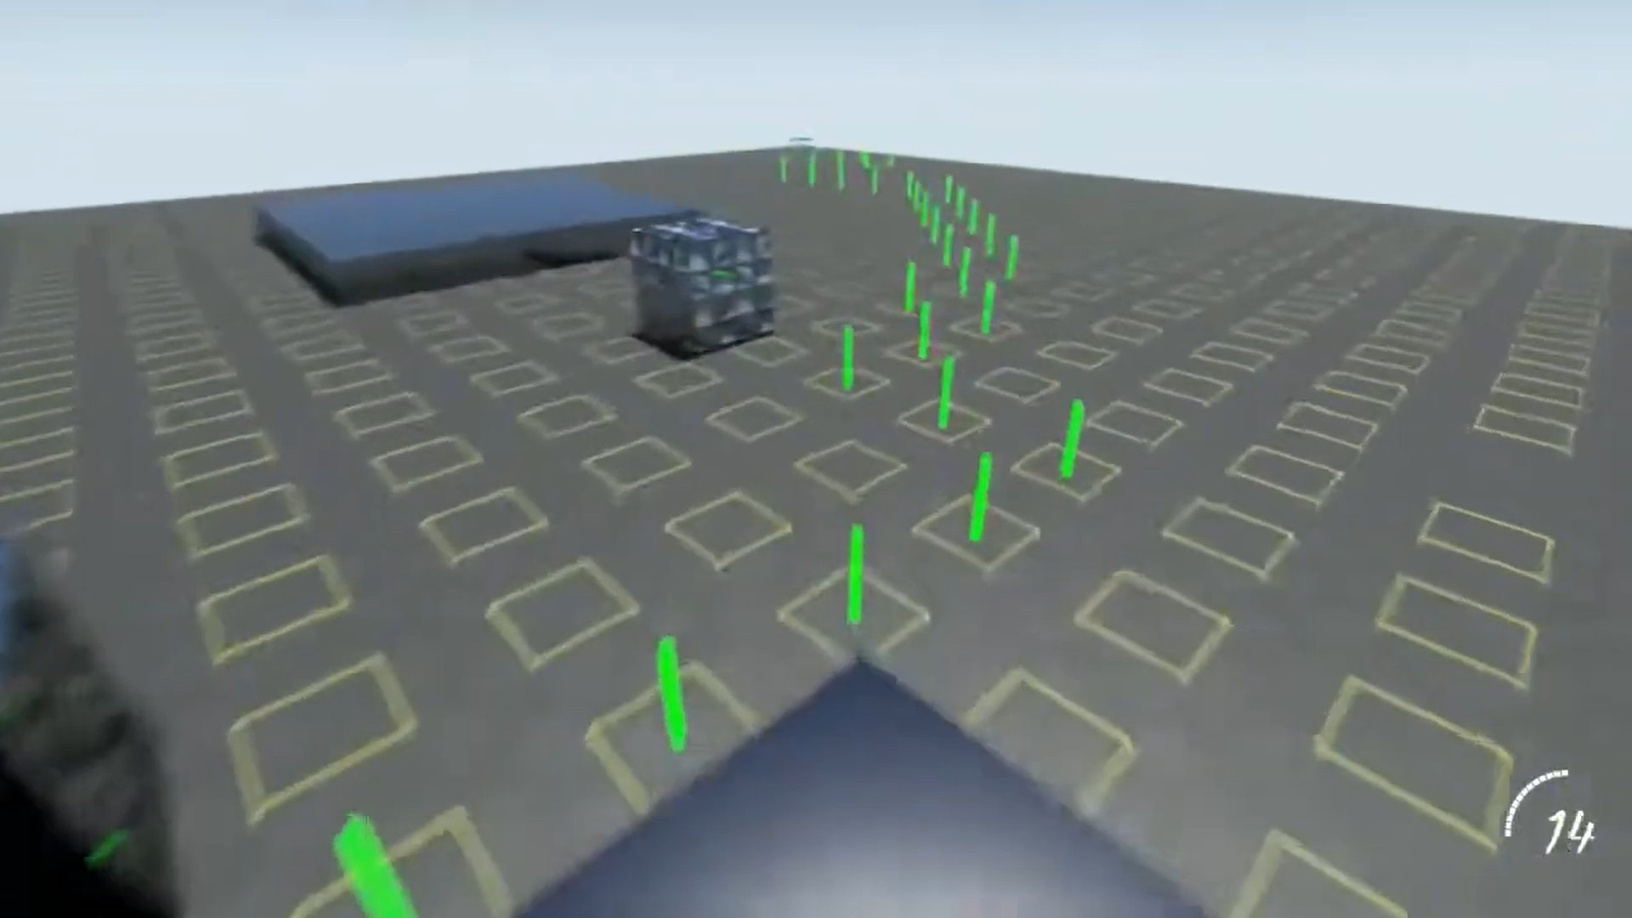

Slide 17
REFERENCES
IntechOpen. (2023). Nanotechnology in Drug Delivery.
Journal of Nanobiotechnology. (2023). Nano based drug delivery systems: recent developments.
PMC. (2023). Applications of nanoparticle systems in drug delivery technology.
Spandidos Publications. (2021). Nanotechnology and its use in imaging and drug delivery.
Wiley Online Library. (2021). The emerging role of nanotechnology in cell and organ transplantation.
Nano Convergence. (2021). Organ-on-a-chip technology for nanoparticle research.
PMC. (2016). Principles of nanoparticle design for overcoming biological barriers to drug delivery.
Nature Reviews Drug Discovery. (2020). Advances in nanomedicine for targeted therapy.

Slide 18
"Advanced Drug Delivery Reviews. (2019). Nanoparticles as drug delivery systems: A review.
ACS Nano. (2018). Recent advances in nanocarrier-based drug delivery systems.
Molecular Pharmaceutics. (2017). Design considerations for nanoparticles as drug carriers.
Nature Biotechnology. (2016). Targeted drug delivery using nanoparticles: Current trends and future directions.
Journal of Controlled Release. (2015). Nanoparticles for targeted therapy: Advances and challenges.
Biomaterials Science. (2014). Engineering nanoparticles for targeted drug delivery applications.
Trends in Biotechnology. (2013). The role of nanotechnology in biomedical applications.

Slide 19
THANK YOU

